Slide 1
Securing FIWARE Architectures
Jason Fox, Senior Technical Evangelist
FIWARE Foundation

Slide 2
Learning Goals
What are Identity Management and Access Control?
Which FIWARE components will you need?
What are Authentication and Authorization?
How do they differ?
What is OAuth2? What flows are supported?
What is a PEP Proxy? What does it do?
What is a PDP and when will I need one?
What terms such as RBAC, PBAC and XACML mean and how are they used?

Slide 3
FIWARE Catalogue
Real-time processing of context events (Perseo)
Creation of
Application Dashboards (Wirecloud)
Big Data Context Analysis (Cosmos)
Real-time Processing of media streams (Kurento)
Business Intelligence (Knowage)
Context Processing, Analysis, Visualization
Handling authorization and access control to APIs (Keyrock, Wilma,
AuthZForce, APInf )
Cloud Edge (FogFlow)
Development of
Context-aware applications
(Orion, STH-Comet,
Cygnus, QuantumLeap, Draco)
Core Context Management (Context Broker)
Data/API Management
Publication Monetization
Deployment tools
Publication and Monetization of Context Information (CKAN extensions, Data/API Biz Framework, IDRA)
Interface to IoT, Robotics and third party systems
Connection to the Internet of Things (IDAS, OpenMTC)
Connection to robots (Fast RTPS,Micro XRCE-DDS)
Documents exchange (Domibus)

Slide 4
IAM Generic Enablers Identity & Access Control Management
Keyrock – Identity Management
Wilma – PEP Proxy
AuthZForce – Authorization PDP

Slide 5

Keyrock Main features
Web Interface and Rest API for managing Identity
Users, devices and groups management
OAuth 2.0 - based Single Sign On
Application - scoped roles and permissions management
Support for local and remote PAP/PDP
JSON Web Tokens (JWT) and Permanent Tokens support
MySQL / PostgreSQL and external DB driver
European eID authentication compatibility (CEF eIDAS)

Slide 6
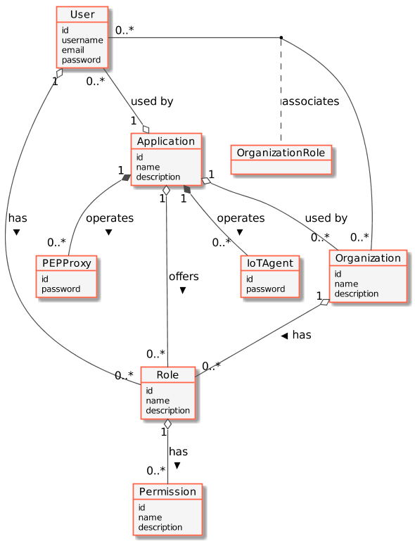
Keyrock : Identity Management
Application - A securable FIWARE application consisting of a series of microservices
User - Any human actor interacting with a FIWARE Application
Organization - A group of users who can be assigned a series of rights. Organization Role - An association allowing certain users to administer all rights
RBAC
Role - A descriptive bucket for a set of permissions assignable to either a single user or an organization.
Permission - An ability to do something on a resource within the system
Other Actors
PEP Proxy - A proxy for use between generic enablers challenging the rights of a user.
IoT Agent - A proxy between IoT Sensors and the Context Broker

Slide 7
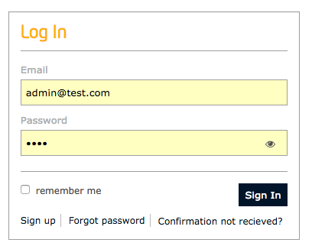
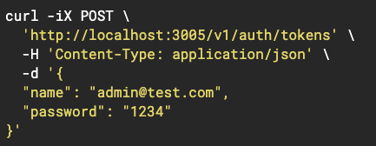
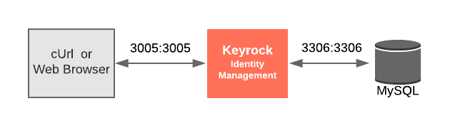
Keyrock : Identity Manager
Offers GUI-based or API-based interaction to administrate users, roles and permissions.
Allows admins to associate users to roles, roles to applications etc.
The API is a simple REST API enabling simple CRUD actions via the usual HTTP Verbs
Simple Policy Decision Point (PDP) also available

Slide 8
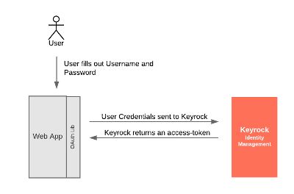
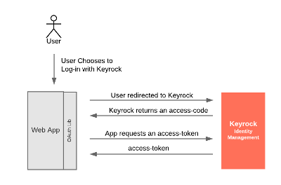
OAuth 2 : Common Grant Types
OAuth 2.0 is the industry-standard protocol for authorization https://oauth.net/2/ several common grant types defined
User Credentials Grant
A User wants to log into an application via a web-app client
The web-app client is absolutely trusted
Authorization Code Grant
Application doesn’t need to store or use passwords directly
Just needs to confirm who the user is from a trusted source

Slide 9

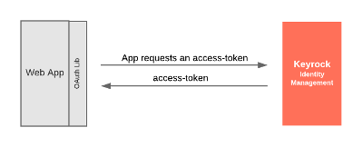
OAuth 2 : Common Grant Types
Implicit Grant
Retrieves access token directly
Simplified form, used by some client side applications
Client Credentials Grant
No user involved
Used when the application itself, not the user needs access
Refresh Token
Exchange a token for a new one

Slide 10

Wilma Main features
PEP Proxy for securing service backends
Basic and complex AC policies support
OAuth 2.0 Access Tokens support
JSON Web Tokens (JWT) support
Custom PDP configuration
Integrated with API Management tools
APInf & API Umbrella
Kong

Slide 11
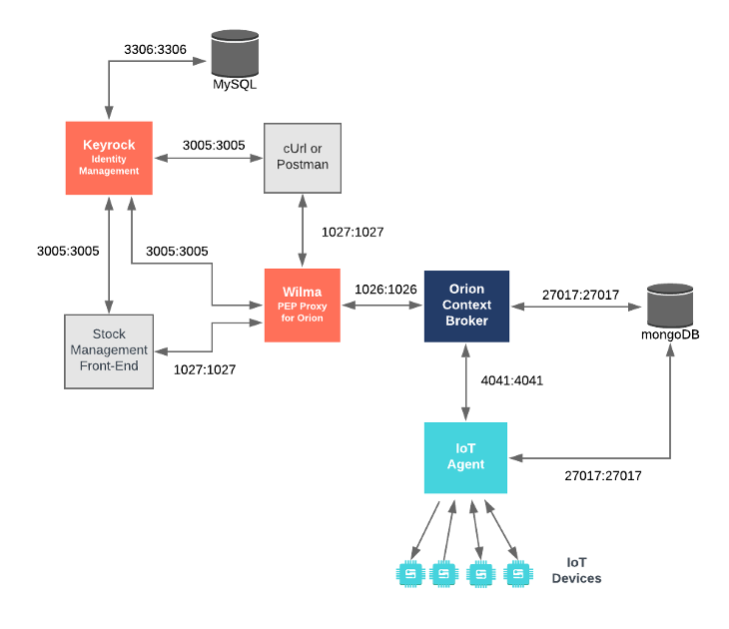
Wilma : PEP Proxy
Offers a Policy Execution Point (PEP) to protect other microservices
Request must provide X-Auth-Token header signifying who (or what) is making the request.
Token is obtained via an OAuth Flow
PEP Proxy passes information on to a Policy Decision Point (such a Keyrock) to make a permit/deny decision on the request.
Keyrock PDP adjudicates based on authentication or Role-based Access Control RBAC

Slide 12

AuthZForce Main features
PAP and PDP Server for managing complex AC policies
XACML-3.0 standard-compliant
Cloud-ready RESTful ABAC framework with XML optimization
Multi-tenant REST API for PDP and PAP
Standards:
OASIS: XACML 3.0 + Profiles (REST, RBAC, Multiple Decision)
ISO: Fast Infoset
Extensible to attribute providers (PIP), functions, etc.

Slide 13
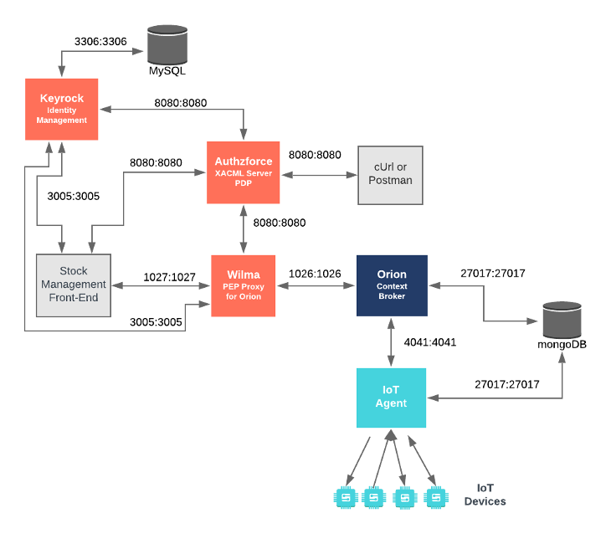
Authzforce : Policy-based Access control
PEP Proxy passes information on to a Policy Decision Point to make a permit/deny decision on the request.
Keyrock declines to adjudicate
Authzforce used to make final decision
Authzforce is an XACML Server offering Policy-Based Access control PBAC:
Policies written in XML
Policies can be complex
Policies can be altered on the fly
Use Authzforce for fine grained access control.

Slide 14
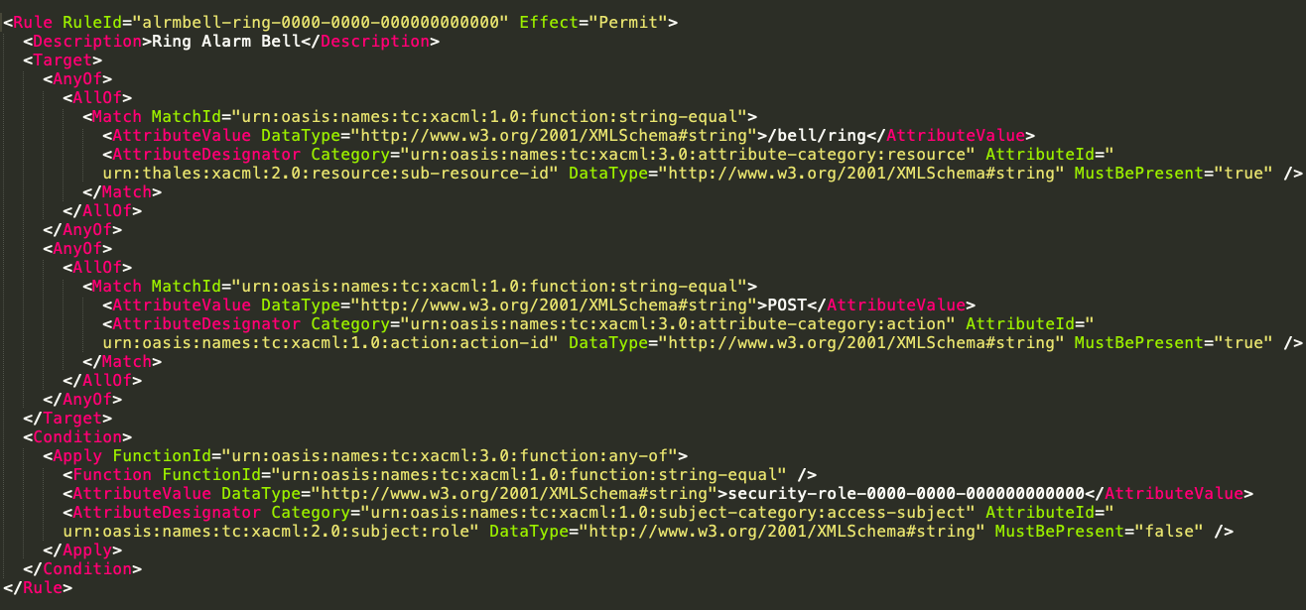
XACML - Defining Complex Access Policies
XACML policies are split into a hierarchy:
<PolicySet>
<Policy>
<Rule>
Each <Rule> within a <Policy> is evaluated as to whether it should grant access to a resource
The overall <Policy> result is defined by the result of all <Rule> elements processed in turn.
Separate <Policy> results are then evaluated against each other using combining algorithms define which <Policy> wins in case of conflict.
A <Rule> element consists of a <Target> and a <Condition>.

Slide 15
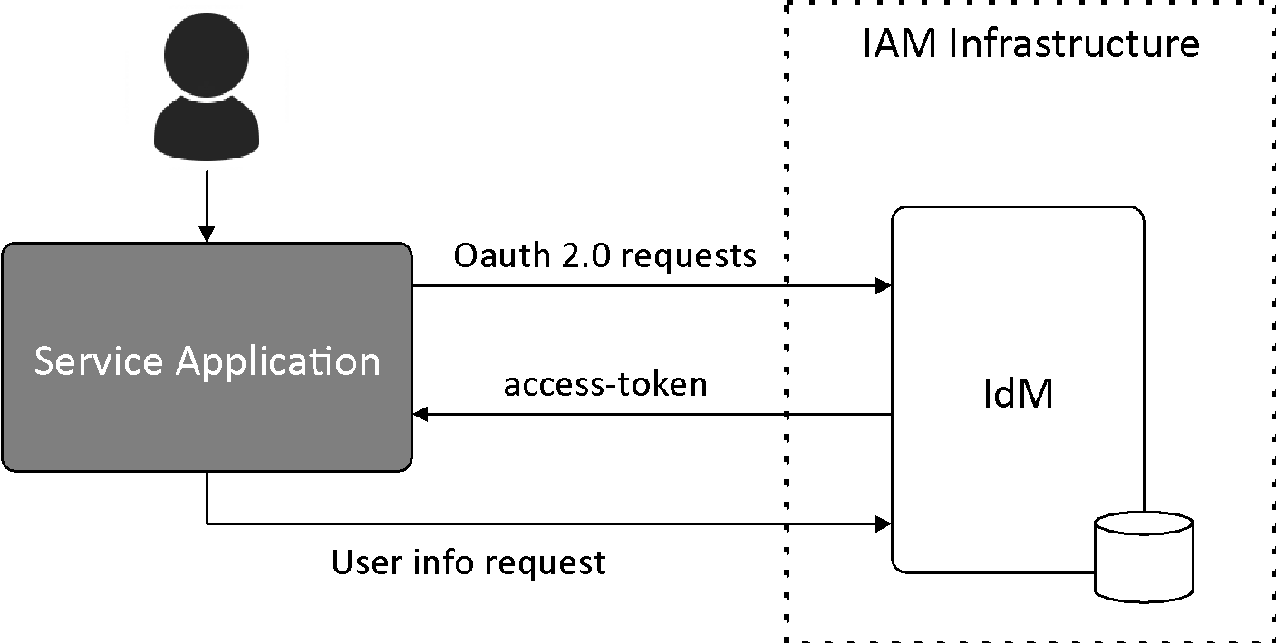

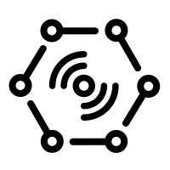
Identity and AC Management OAuth 2.0 flow

Slide 16
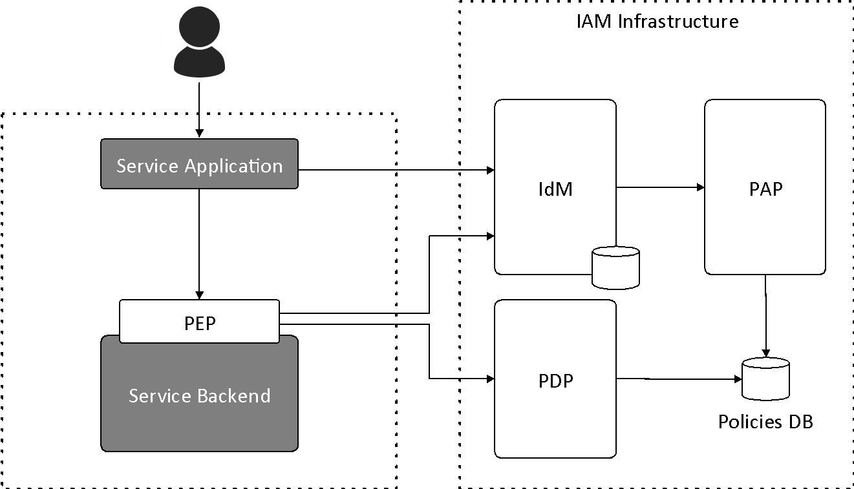
Identity and AC Management Accessing GEs and services
OAuth2 flow
Request
+ token
Check auth

Slide 17
Identity and AC Management Accessing GEs and services
Level 1: Authentication
Level 2: Basic Authorization
Level 3: Advanced Authorization

Slide 18
Identity and AC Management Accessing GEs and services
Level 1: Authentication
Check if a user has been authenticated
Level 2: Basic Authorization
Level 3: Advanced Authorization

Slide 19


Identity and AC Management Level 1: Authentication
IAM Infrastructure
IdM
Service Application
OAuth2 flow
Request
+ token
Check token
PEP
Service Backend

Slide 20
Identity and AC Management Accessing GEs and services
Level 1: Authentication
Level 2: Basic Authorization
Checks if a user has permissions to access a resource
HTTP verb + resource path
Level 3: Advanced Authorization

Slide 21
Identity and AC Management Level 2: Basic Authorization
IAM Infrastructure
IdM
PAP
PDP
Service Application
OAuth2 flow
Request
+ token
Check token
PEP
Service Backend

Slide 22
Identity and AC Management Accessing GEs and services
Level 1: Authentication
Level 2: Basic Authorization
Level 3: Advanced Authorization
Custom XACML policies

Slide 23
Identity and AC Management Level 3: Advanced Authorization
IAM Infrastructure
IdP
PAP
Service Application
OAuth2 flow
Request
+ token
Check token
PEP
PDP
Service Backend
Check auth
Policies DB

Slide 24
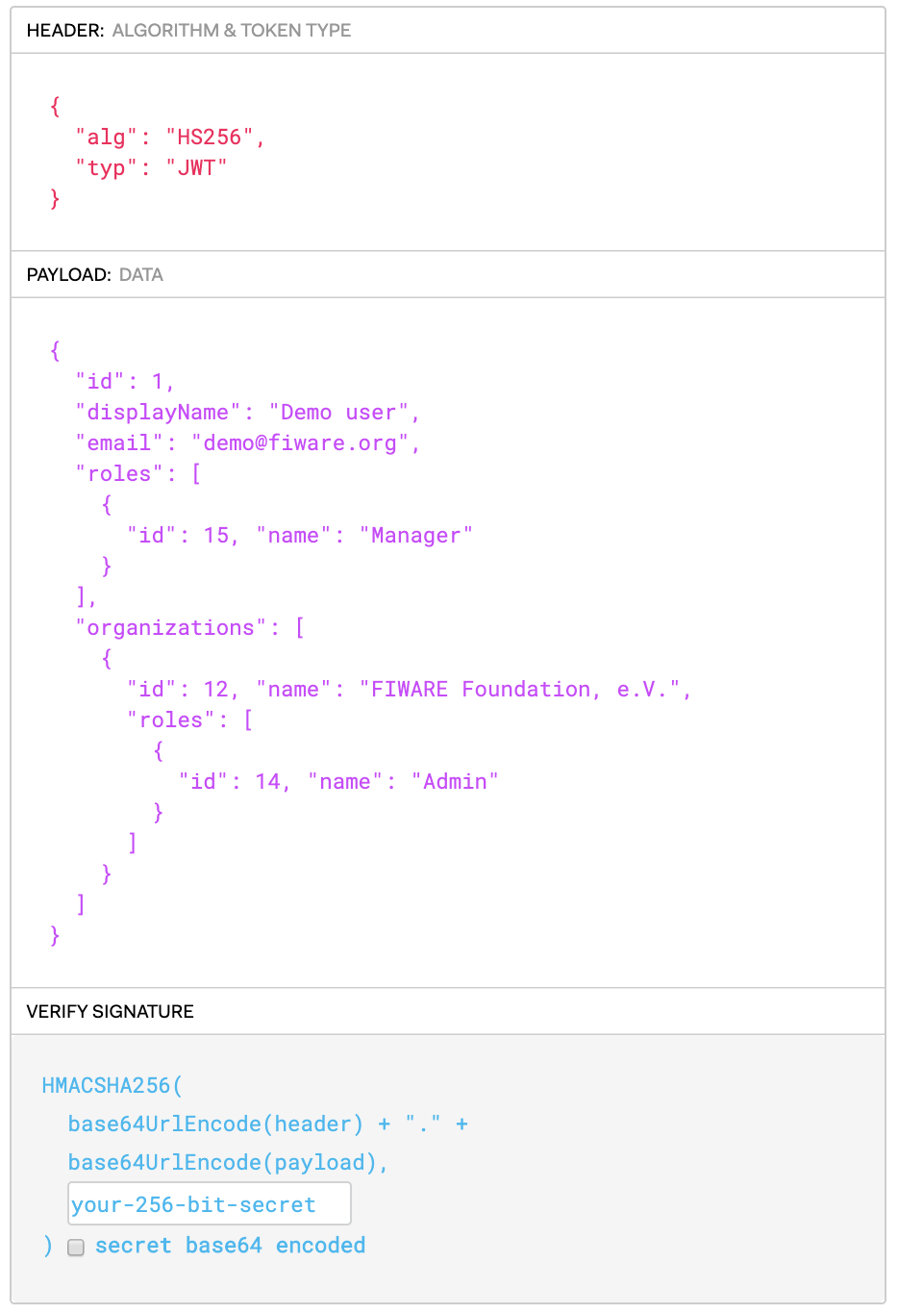
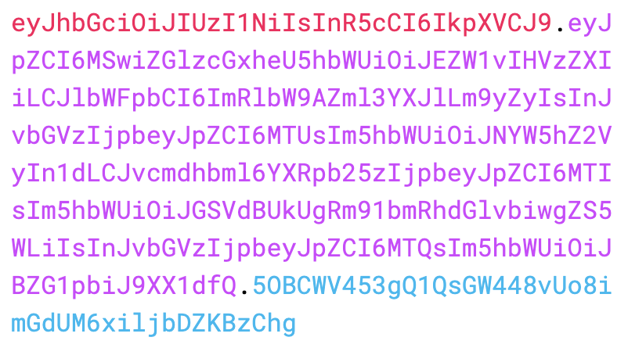

Identity and AC Management JSON Web Tokens
A JSON Web Token (JWT) is a JSON object defined in RFC 7519 as a safe way to represent a set of information between two parties.
The token is composed of a header, a payload, and a signature.
Encoded
Decoded

Slide 25


eID Integration CEF eIDAS
eIDAS (electronic IDentification, Authentication and trust Services) is an EU regulation to enable secure and seamless electronic interactions between businesses, citizens and public authorities.
Access to European services by national eID
eIDAS
country 2
eID
Service
eIDAS
country 1
User country 2
eIDAS
country 3

Slide 26


eID Integration FIWARE Identity Gateway
Integration of FIWARE Security Framework with eIDAS
Every application registered in Keyrock can be linked to a eIDAS node
By an OAuth 2.0 – SAML2 gateway
Users can then authenticate using their national eID
AC policies based on user eIDAS profile
Transparent for applications providers

Slide 27
eID Integration FIWARE Identity Gateway
IAM Infrastructure
eIDAS
Authentication
eIDAS node 1
IdP
SAML flow
Service Application
Oauth 2.0 requests
IdP 1
access-token
eIDAS node 2
User info request
IdP 2
…

Slide 28
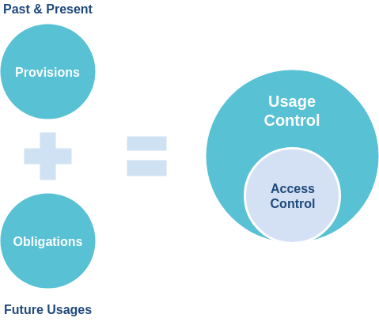
Data Usage Control
Security Framework and Data Usage Control
Ensures data sovereignty
Regulates what is allowed to happen with the data (future usage).
Integration with Big Data and Processing GEs

Slide 29
Summary: Terms
Identity Management ensures that only the right individuals get access to resources
Usernames, passwords
Roles and permissions
etc...
Access Control is the selective restriction of access to resources
Authentication is a mechanism to confirm you are who you claim to be.
i.e. Who are you?
Authorization is a mechanism to ensure you have permission to access a resource
i.e Is X allowed to do Y to Z?
Authorization can be either Role Based (RBAC) or Policy Based (PBAC)
When attempting to gain access you pass the PEP - Policy Execution Point
You are either granted or denied access by a PDP - Policy Decision Point
Administrators can set up rules using a PAP - Policy Administration Point

Slide 30
Summary: FIWARE Generic Enablers
Keyrock - Identity Management to know who can do what
GUI based or API based
Supports human and machine users (such as IoT Agents)
Flexible Role-based administration
Multi-Tenant
OAuth2 Compliant
Simple PDP - Authentication or RBAC Authorization
Wilma PEP Proxy - Gatekeeper to confirm permissions prior to access
User identified via a header within the request
Links to either Keyrock or Authzforce
Code can be extended for advanced scenarios
Authzforce - Adjudicator to either permit or deny when given information
XACML based ruleset can be modified on the fly
Used in advanced scenarios PBAC Authorization
Alternatives are available e.g. Keystone, Steelskin, IDSA Security
Always use the most appropriate tools for your use-case

Slide 31
Security GEs documentation
FIWARE Catalogue
https://www.fiware.org/developers/catalogue
FIWARE Academy
https://fiware-academy.readthedocs.io/en/latest/index.html
Identity Management – Keyrock
Repo: https://github.com/ging/fiware-idm
PEP Proxy – Wilma
Repo: https://github.com/ging/fiware-pep-proxy
Authorization PDP – AuthZForce
Repo: https://github.com/authzforce/server

